Slide 1
General informations
What is Legacy BIOS
What is UEFI
What is MBR partition
What is GPT partition

Slide 2
LEGACY BIOS
In IBM PC compatible computers, the Basic Input/Output System (BIOS), also known as System BIOS, ROM BIOS or PC BIOS, is a de facto standard defining a firmware interface.
The fundamental purposes of the BIOS are to initialize and test the system hardware components, and to load a bootloader or an operating system from a mass memory device.
The BIOS additionally provides abstraction layer for the hardware, i.e. a consistent way for application programs and operating systems to interact with the keyboard, display, and other input/output devices.
Variations in the system hardware are hidden by the BIOS from programs that use BIOS services instead of directly accessing the hardware.

Slide 3

UEFI
The Unified Extensible Firmware Interface (UEFI) is a specification that defines a software interface between an operating system and platform firmware.
UEFI is meant to replace the Basic Input/Output System (BIOS) firmware interface, originally present in all IBM PC-compatible personal computers
UEFI can support remote diagnostics and repair of computers, even without another operating system.
Intel developed the original EFI (Extensible Firmware Interface) specification. Some of the EFI's practices and data formats mirror those from Microsoft Windows.

Slide 4
CONTINUED…
The original motivation for EFI came during early development of the first Intel–HP Itanium systems in the mid-1990s. BIOS limitations (such as 16-bit processor mode, 1 MB addressable space and PC AT hardware) were unacceptable for the larger server platforms Itanium was targeting.
The effort to address these concerns began in 1998 and was initially called Intel Boot Initiative; it was later renamed to EFI.
The current UEFI specification, version 2.4, was approved in July 2013.

Slide 5
Advantages
The interface defined by the EFI specification includes data tables that contain platform information, and boot and runtime services that are available to the OS loader and OS. UEFI firmware provides several technical advantages over a traditional BIOS system.
Ability to boot from large disks (over 2 TB) with a GUID Partition Table (GPT)
CPU-independent architecture
CPU-independent drivers
flexible pre-OS environment, including network capability
modular design

Slide 6
UEFI vs Legacy BIOS
UEFI enables better use of bigger hard drives.
Though UEFI supports the traditional master boot record (MBR) method of hard drive partitioning, it doesn't stop there,It's also capable of working with the GUID Partition Table (GPT), which is free of the limitations the MBR places on the number and size of partitions.
UEFI may be faster than the BIOS.
Various tweaks and optimizations in the UEFI may help your system boot more quickly it could before.

Slide 7
CONTINUED…
However, UEFI is still not widespread.
Though major hardware companies have switched over almost exclusively to UEFI use, you still won't find the new firmware in use on all motherboards—or in quite the same way across the spectrum.
Many older and less expensive motherboards also still use the BIOS system.

Slide 8
MBR
A master boot record (MBR) is a special type of boot sector at the very beginning of partitioned computer mass storage devices like fixed disks or removable drives intended for use with IBM PC-compatible systems and beyond. The concept of MBRs was publicly introduced in 1983 with PC DOS 2.0.
The MBR holds the information on how the logical partitions, containing file systems, are organized on that medium
This MBR code is usually referred to as a boot loader.
MBR partition entries and the MBR boot code used in commercial operating systems, however, are limited to 32 bits.
Therefore, the maximum disk size supported on disks using 512-byte sectors (whether real or emulated) by the MBR partitioning scheme (without using non-standard methods) is limited to 2 TB

Slide 9
GPT
GUID Partition Table (GPT) is a standard for the layout of the partition table on a physical hard disk, using globally unique identifiers (GUID).
Although it forms a part of the Unified Extensible Firmware Interface (UEFI) standard (Unified EFI Forum proposed replacement for the PC BIOS), it is also used on some BIOS systems because of the limitations of master boot record(MBR) partition tables, which use 32 bits for storing logical block addresses (LBA) and size information.
GPT allocates 64 bits for logical block addresses, therefore allowing a maximum disk size of 2⁶⁴ sectors

Slide 10
MBR vs GPT
Compared with MBR disk, A GPT disk can support larger than 2 TB volumes where MBR cannot.
A GPT disk can be basic or dynamic, just like an MBR disk can be basic or dynamic.
GPT disks also support up to 128 partitions rather than the 4 primary partitions limited to MBR.
Also, GPT keeps a backup of the partition table at the end of the disk.
Furthermore, GPT disk provides greater reliability due to replication and cyclical redundancy check (CRC) protection of the partition table.

Slide 11
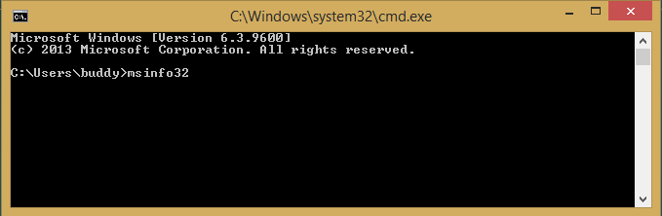
Method to find BIOS mode: (UEFI or LEGACY BIOS)
Just fire up MSINFO32 in cmd prompt

Slide 12
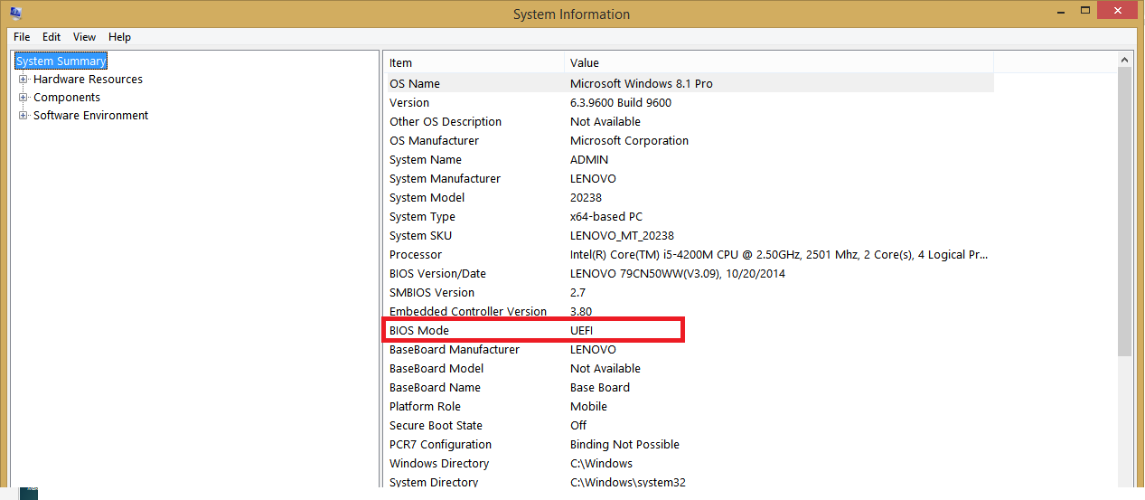

Slide 13
Steps to find GPT or MBR partition
In the system:
Open Disk Management: Start > Control Panel > Administrative Tools > Computer Management > Disk Management.
Right click on the Disk # box
NOTE: The smaller box on the left, with the Disk #, not the larger volume boxes

Slide 14
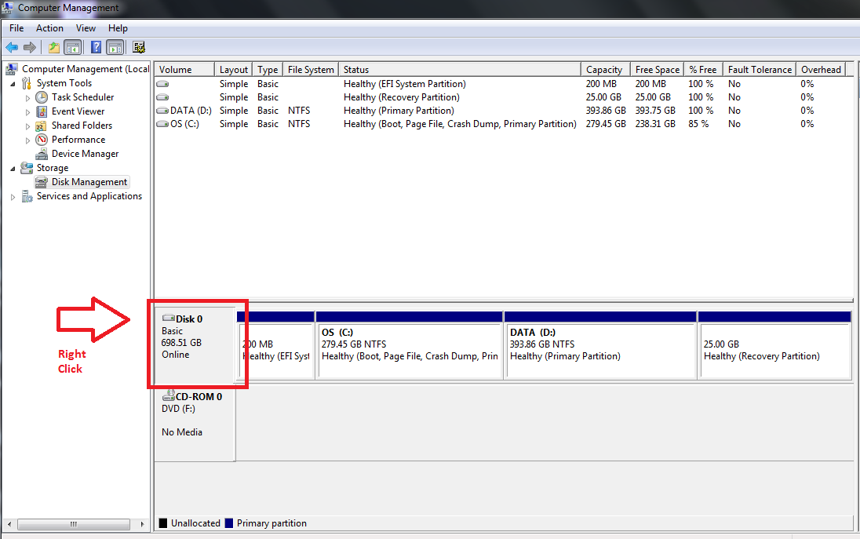

Slide 15
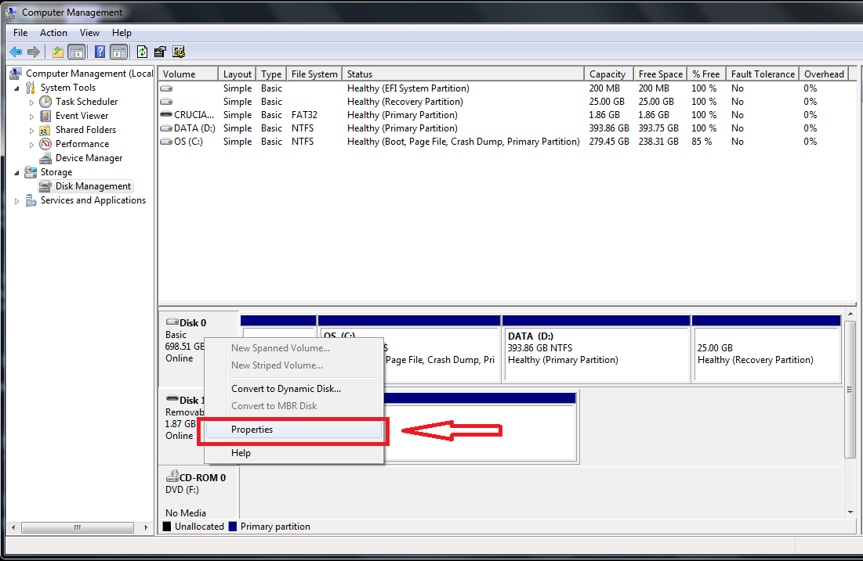
3. Select Properties

Slide 16
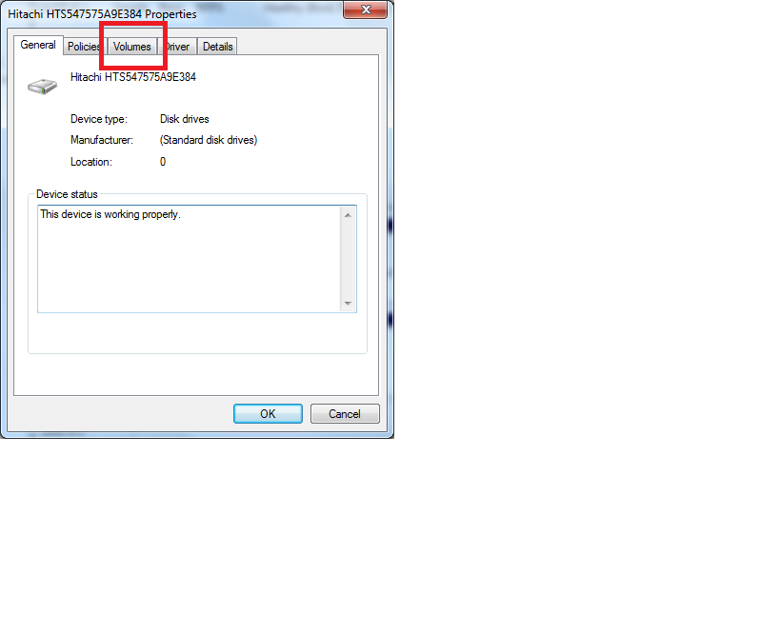
4. Click the Volumes tab

Slide 17
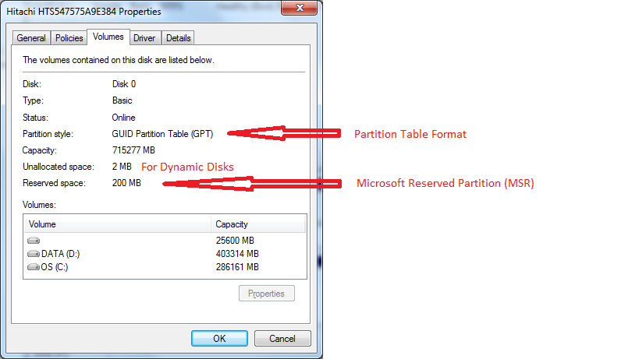
5. Next to Partition Style, it will list the format as "Master Boot Record (MBR)" or “GUID Partition Table (GPT)”

Slide 18
REMEMBER!
It is not possible to convert MBR to GPT partition without formatting the disk
To convert MBR to GPT one should take a backup of all files to external hard disk , then format your disk.
Now make a new GPT partition

